Slide 1
Lecture 8-IBFE-Going through a main file

Slide 2
IBAMR
What Is IBAMR?
IBAMR is a distributed-memory parallel implementation of the immersed boundary (IB) method with support for Cartesian grid adaptive mesh refinement (AMR). Support for distributed-memory parallelism is via MPI, the Message Passing Interface.
Core IBAMR functionality relies upon several high-quality open-source libraries, including:
SAMRAI, the Structured Adaptive Mesh Refinement Application Infrastructure
PETSc, the Portable, Extensible Toolkit for Scientific Computation
libMesh, a C++ finite element library
hypre, a library of high performance preconditioners that features parallel multigrid methods for both structured and unstructured grid problems.
IBAMR also uses functionality provided by a number of additional third-party libraries, including: Boost; Eigen; HDF5; muParser; and Silo.
IBAMR outputs visualization files that can be read by the VisIt Visualization Tool.
https://github.com/IBAMR/IBAMR/wiki

Slide 3
Getting Started
IBAMR requires a number of third-party libraries. Sample build instructions are provided for a typical Linux installation and macOS. We offer experimental support the use of Windows 10 through the Windows Subsystem for Linux (WSL); refer to the Linux directions in that case.

Slide 4
Documentation
https://ibamr.github.io/docs
In general, I perform searches here to learn more about various functions and classes.
There are also tabs for “Namespaces” and “Classes”
https://www.tutorialspoint.com/cplusplus/cpp_namespaces.htm
https://www.tutorialspoint.com/cplusplus/cpp_classes_objects.htm
At some point, I recommend really learning C++
https://www.tutorialspoint.com/cplusplus/

Slide 5
Namespaces
Consider a situation, when we have two persons with the same name, Zara, in the same class. Whenever we need to differentiate them definitely we would have to use some additional information along with their name, like either the area, if they live in different area or their mother’s or father’s name, etc.
Same situation can arise in your C++ applications. For example, you might be writing some code that has a function called xyz() and there is another library available which is also having same function xyz(). Now the compiler has no way of knowing which version of xyz() function you are referring to within your code.
A namespace is designed to overcome this difficulty and is used as additional information to differentiate similar functions, classes, variables etc. with the same name available in different libraries. Using namespace, you can define the context in which names are defined. In essence, a namespace defines a scope.
https://www.tutorialspoint.com/cplusplus/cpp_namespaces.htm

Slide 6
Classes
The main purpose of C++ programming is to add object orientation to the C programming language and classes are the central feature of C++ that supports object-oriented programming and are often called user-defined types.
A class is used to specify the form of an object and it combines data representation and methods for manipulating that data into one neat package. The data and functions within a class are called members of the class.

Slide 7
Going through an example
I am going to go through the IBFE ex7.
The approach I will use can be applied to understanding other IBAMR examples.

Slide 8
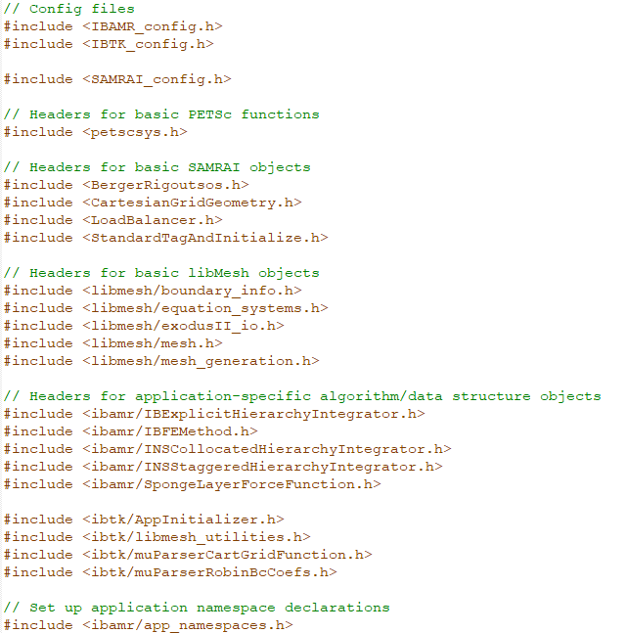
Header files to start main.C for IBFE

Slide 9
Header files in general
A header file is a file with extension .h which contains C function declarations and macro definitions to be shared between several source files. There are two types of header files: the files that the programmer writes and the files that comes with your compiler.
You request to use a header file in your program by including it with the C preprocessing directive #include, like you have seen inclusion of stdio.h header file, which comes along with your compiler.
Including a header file is equal to copying the content of the header file but we do not do it because it will be error-prone and it is not a good idea to copy the content of a header file in the source files, especially if we have multiple source files in a program.
https://www.tutorialspoint.com/cprogramming/c_header_files.htm#:~:text=A%20header%20file%20is%20a,that%20comes%20with%20your%20compiler.

Slide 10
An example header file
#include <ibamr/SpongeLayerForceFunction.h>
Detailed Description
Class SpongeLayerForceFunction provides forcing at physical boundaries that weakly imposes homogeneous Dirichlet boundary conditions.
The documentation for this class was generated from the following files:
/home/travis/build/IBAMR/IBAMR/include/ibamr/SpongeLayerForceFunction.h
/home/travis/build/IBAMR/IBAMR/src/navier_stokes/SpongeLayerForceFunction.cpp

Slide 11
Elasticity model data
namespace ModelData{
…..
Declare functions PK1_stress_function, tether_force_function, etc. here

Slide 12
Main function
Int
main(int argc, char* argv[])
{
// Initialize libMesh, PETSc, MPI, and SAMRAI.
LibMeshInit init(argc, argv);
SAMRAI_MPI::setCommunicator(PETSC_COMM_WORLD);
SAMRAI_MPI::setCallAbortInSerialInsteadOfExit();
SAMRAIManager::startup();
{ // cleanup dynamically allocated objects prior to shutdown

Slide 13
Enable file logging
// Parse command line options, set some standard options from the input
// file, initialize the restart database (if this is a restarted run), and enable file logging.
Pointer<AppInitializer> app_initializer = new AppInitializer(argc, argv, "IB.log");
Pointer<Database> input_db = app_initializer->getInputDatabase();
// Get various standard options set in the input file.
const bool dump_viz_data = app_initializer->dumpVizData();
const int viz_dump_interval = app_initializer->getVizDumpInterval();
const bool uses_visit = dump_viz_data && app_initializer->getVisItDataWriter();
#ifdef LIBMESH_HAVE_EXODUS_API
const bool uses_exodus = dump_viz_data && !app_initializer->getExodusIIFilename().empty();
#else
const bool uses_exodus = false;
if (!app_initializer->getExodusIIFilename().empty())
{
plog << "WARNING: libMesh was compiled without Exodus support, so no "
<< "Exodus output will be written in this program.\n";
}
#endif
Options for writing visit and exodus data

Slide 14
Enable file logging continued
const bool dump_restart_data = app_initializer->dumpRestartData();
const int restart_dump_interval = app_initializer->getRestartDumpInterval();
const string restart_dump_dirname = app_initializer->getRestartDumpDirectory();
const string restart_read_dirname = app_initializer->getRestartReadDirectory();
const int restart_restore_num = app_initializer->getRestartRestoreNumber();
const bool dump_postproc_data = app_initializer->dumpPostProcessingData();
const int postproc_data_dump_interval = app_initializer->getPostProcessingDataDumpInterval();
const string postproc_data_dump_dirname = app_initializer->getPostProcessingDataDumpDirectory();
if (dump_postproc_data && (postproc_data_dump_interval > 0) && !postproc_data_dump_dirname.empty()) {
Utilities::recursiveMkdir(postproc_data_dump_dirname);
}
const bool dump_timer_data = app_initializer->dumpTimerData();
const int timer_dump_interval = app_initializer->getTimerDumpInterval();
Determine intervals for writing restart files and post processing and writing data.

Slide 15
Looking at the code more carefully
dumpRestartData - Return a boolean value indicating whether to write restart data.
getRestartDumpInterval - Return the restart dump interval. This is set in the Main database of the input file. This can be defined in the input file as restart_interval, restart_dump_interval, or restart_write_interval.
dumpPostProcessingData - Return a boolean value indicating whether to write post processing data.
dumpTimerData - Return a boolean value indicating whether to write timer data.

Slide 16
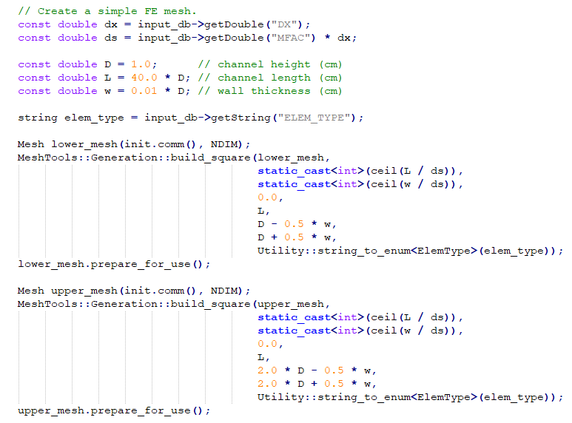
See next slide….

Slide 17
Create meshes using libmesh
These immersed boundaries are geometrically relatively simple, so libmesh is used to make the meshes.
http://libmesh.github.io/
void libMesh::MeshTools::Generation::build_square | ( | UnstructuredMesh & | mesh,
 |  | const unsigned int | nx,
 |  | const unsigned int | ny,
 |  | const Real | xmin = 0.,
 |  | const Real | xmax = 1.,
 |  | const Real | ymin = 0.,
 |  | const Real | ymax = 1.,
 |  | const ElemType | type = INVALID_ELEM,
 |  | const bool | gauss_lobatto_grid = false
 | )

Slide 18
Create a vector of meshes and material properties
vector<MeshBase*> meshes(2);
meshes[0] = &lower_mesh;
meshes[1] = &upper_mesh;
mu_s = input_db->getDouble("MU_S");
lambda_s = input_db->getDouble("LAMBDA_S");
kappa_s = input_db->getDouble("KAPPA_S");
kappa_s = target force stiffness
From PK1 Stress Function,
static const TensorValue<double> II(1.0, 0.0, 0.0, 0.0, 1.0, 0.0, 0.0, 0.0, 1.0);
const TensorValue<double> CC = FF.transpose() * FF;
const TensorValue<double> EE = 0.5 * (CC - II);
const TensorValue<double> SS = lambda_s * EE.tr() * II + 2.0 * mu_s * EE;
PP = FF * SS;

Slide 19
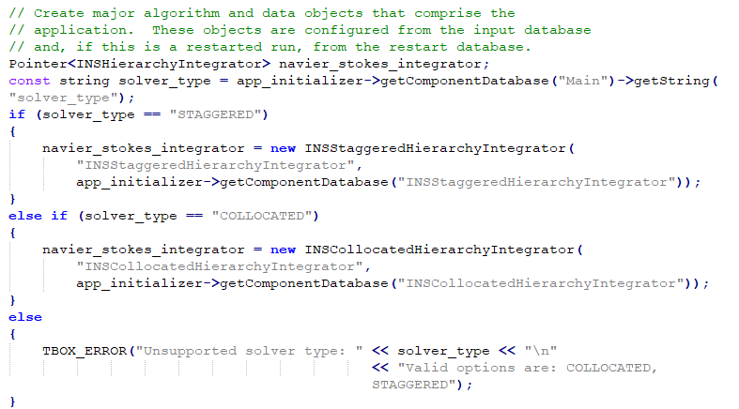
Pick your Navier Stokes solver

Slide 20
N-S solvers
Class INSStaggeredHierarchyIntegrator provides a staggered-grid solver for the incompressible Navier-Stokes equations on an AMR grid hierarchy.
Class INSCollocatedHierarchyIntegrator provides a collocated projection method-based solver for the incompressible Navier-Stokes equations on an AMR grid hierarchy.

Slide 21
Creating the major algorithm cont’d
Class IBFEMethod is an implementation of the abstract base class IBStrategy that provides functionality required by the IB method with finite element elasticity.
Class IBHierarchyIntegrator provides an abstract interface for a time integrator for various versions of the immersed boundary method on an AMR grid hierarchy, along with basic data management for variables defined on that hierarchy.

Slide 22
Configure the IBFE Solver
IBFEMethod::LagBodyForceFcnData lower_tether_force_data(lower_tether_force_function);
ib_method_ops->registerLagBodyForceFunction(lower_tether_force_data, 0);
IBFEMethod::LagBodyForceFcnData upper_tether_force_data(upper_tether_force_function);
IBFEMethod::PK1StressFcnData upper_PK1_stress_data(upper_PK1_stress_function);
ib_method_ops->registerLagBodyForceFunction(upper_tether_force_data, 1);
ib_method_ops->registerPK1StressFunction(upper_PK1_stress_data, 1);
ib_method_ops->initializeFEEquationSystems();
EquationSystems* lower_equation_systems = ib_method_ops->getFEDataManager(0)->getEquationSystems();
EquationSystems* upper_equation_systems = ib_method_ops->getFEDataManager(1)->getEquationSystems();
We reviewed this part when looking at multiple boundaries.

Slide 23
Create Eulerian initial condition specification objects
if (input_db->keyExists("VelocityInitialConditions"))
{
Pointer<CartGridFunction> u_init = new muParserCartGridFunction("u_init", app_initializer->getComponentDatabase("VelocityInitialConditions"), grid_geometry);
navier_stokes_integrator->registerVelocityInitialConditions(u_init);
}
if (input_db->keyExists("PressureInitialConditions"))
{
Pointer<CartGridFunction> p_init = new muParserCartGridFunction("p_init", app_initializer->getComponentDatabase("PressureInitialConditions"), grid_geometry);
navier_stokes_integrator->registerPressureInitialConditions(p_init);
}
Read in velocity or pressure boundary conditions from input file.

Slide 24
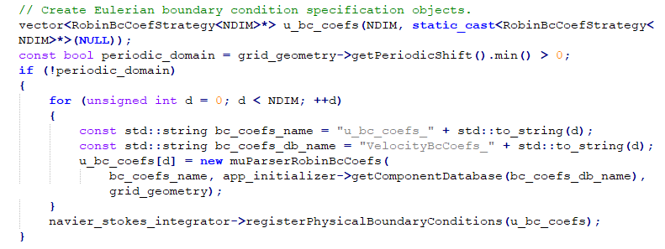
Specify boundary conditions
Read in Robin boundary conditions from input file or use periodic boundary conditions.

Slide 25
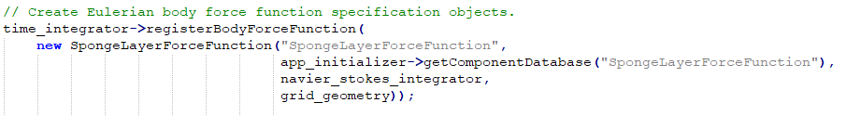
Body force functions
void IBAMR::IBHierarchyIntegrator::registerBodyForceFunction (SAMRAI::tbox::Pointer< IBTK::CartGridFunction > F_fcn)
Supply a body force (optional).
This is optional. Note totally sure what sponge layer does….

Slide 26
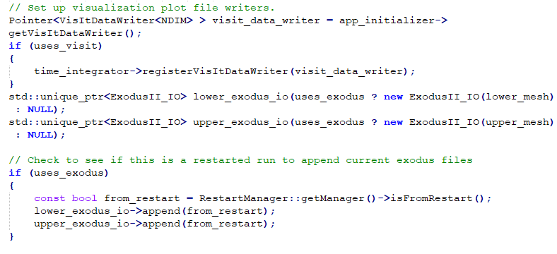
Visualization file writers

Slide 27
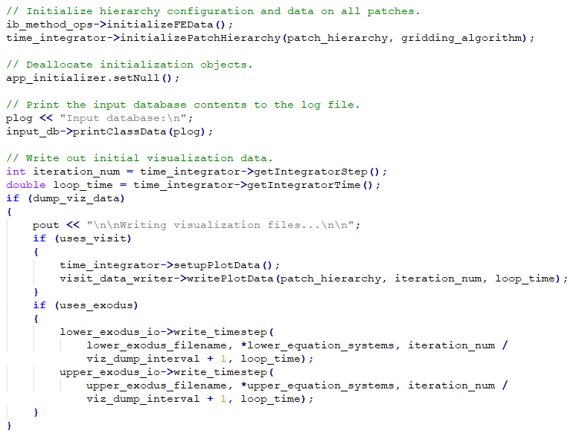
More initialization
Write initial visit and exodus files.

Slide 28
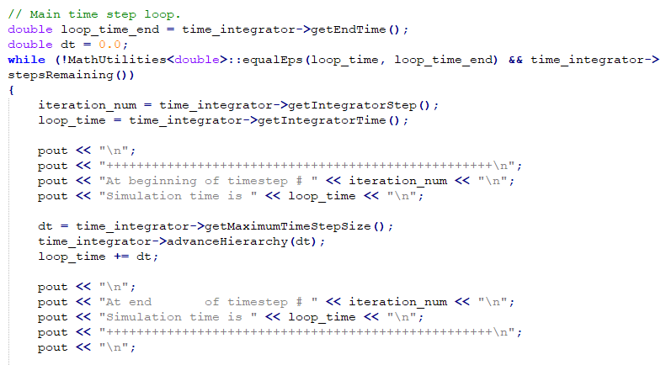
Main time step loop
Write out information such as time step number, simulation time, etc.

Slide 29
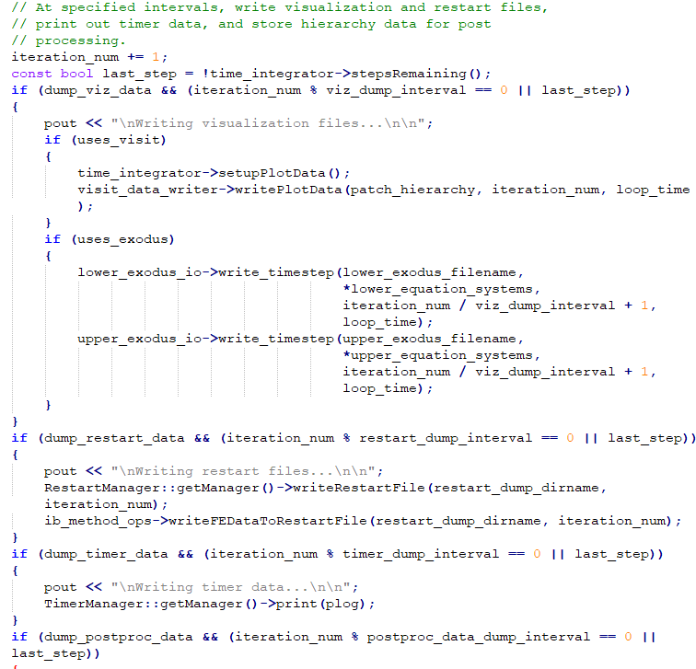

Slide 30
output_data or postprocess_data
void
output_data(Pointer<PatchHierarchy<NDIM> > patch_hierarchy, Pointer<INSHierarchyIntegrator> navier_stokes_integrator, Mesh& mesh, EquationSystems* equation_systems, const int iteration_num, const double loop_time, const string& data_dump_dirname)
This function varies a lot, but is used to output .curve files for velocities, forces, and other data. I recommend looking at a few examples.

